Slide 1




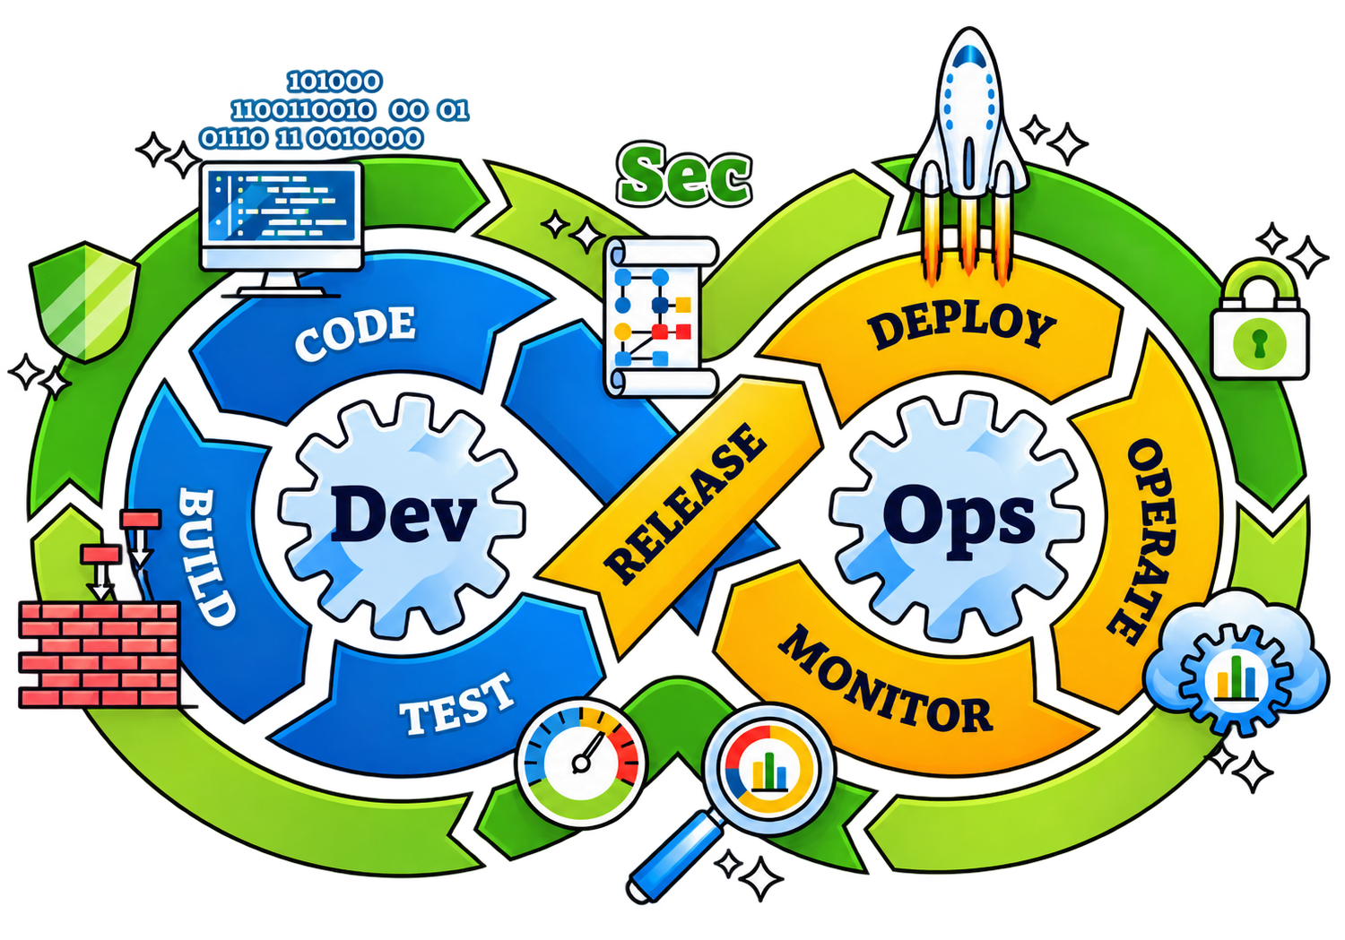
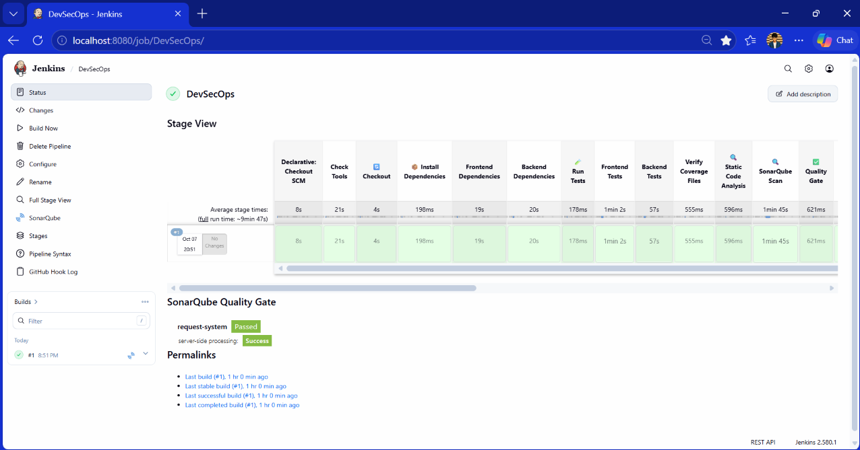
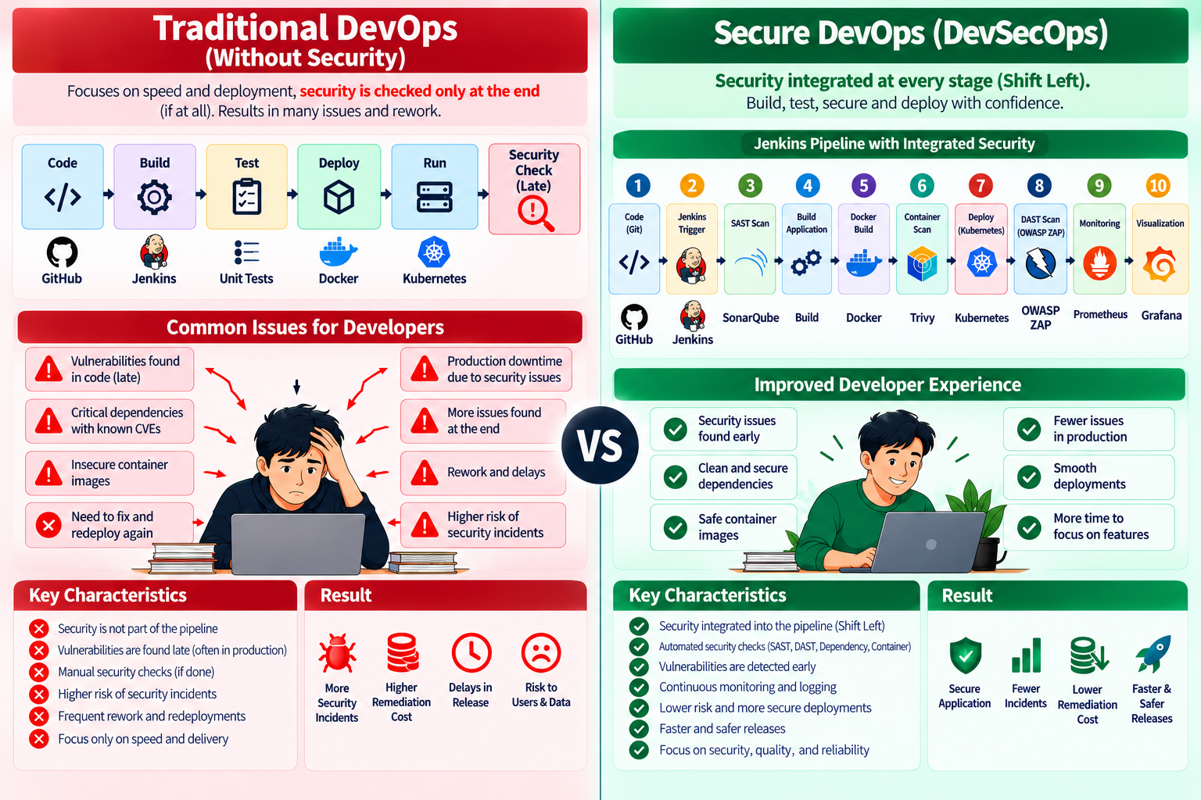
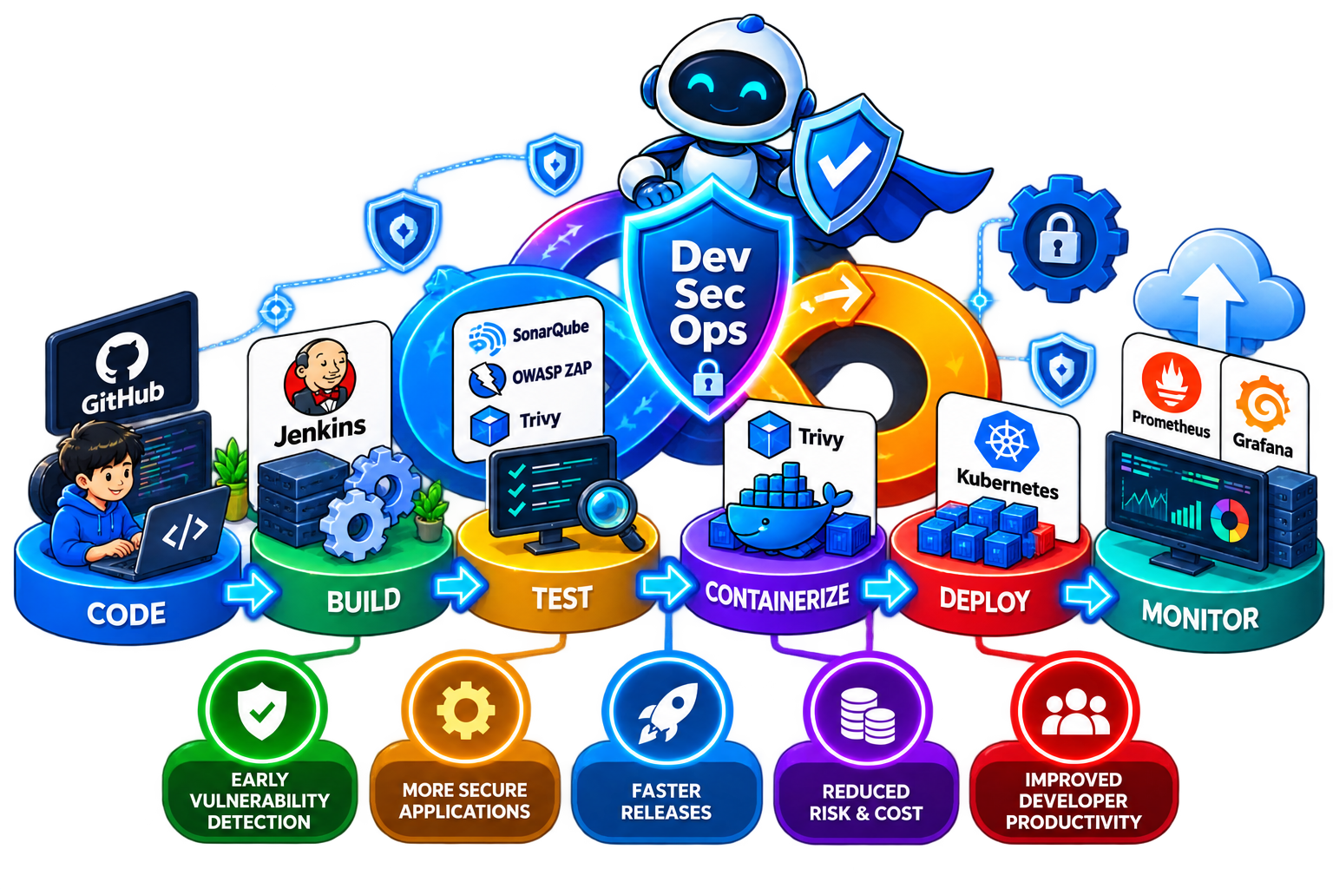
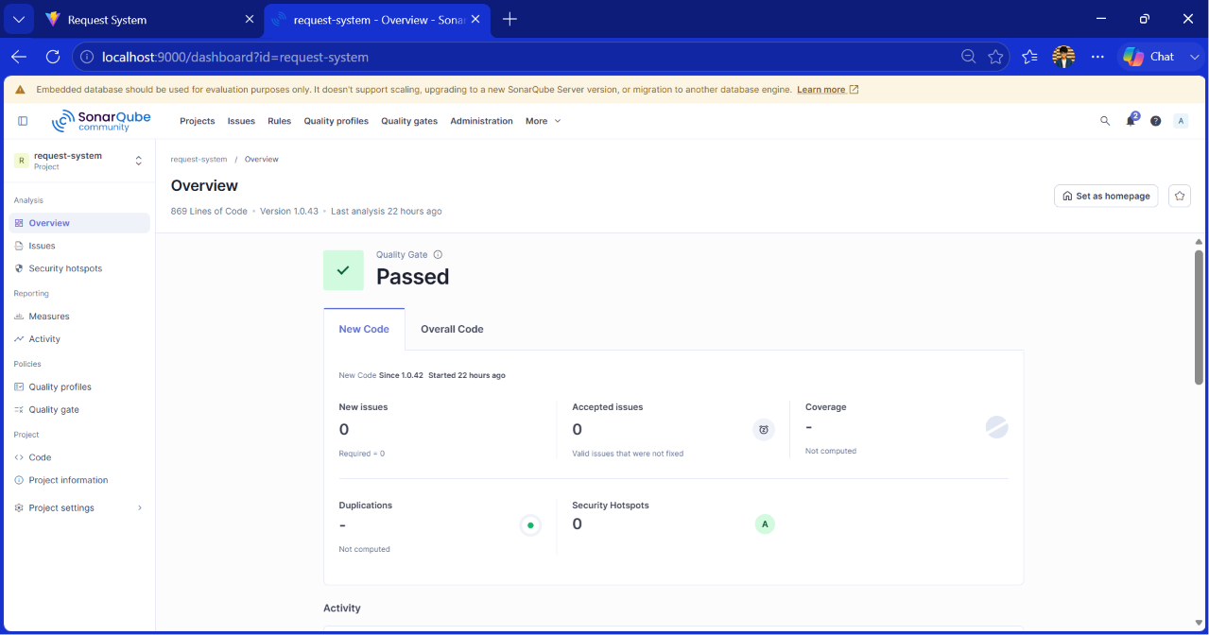
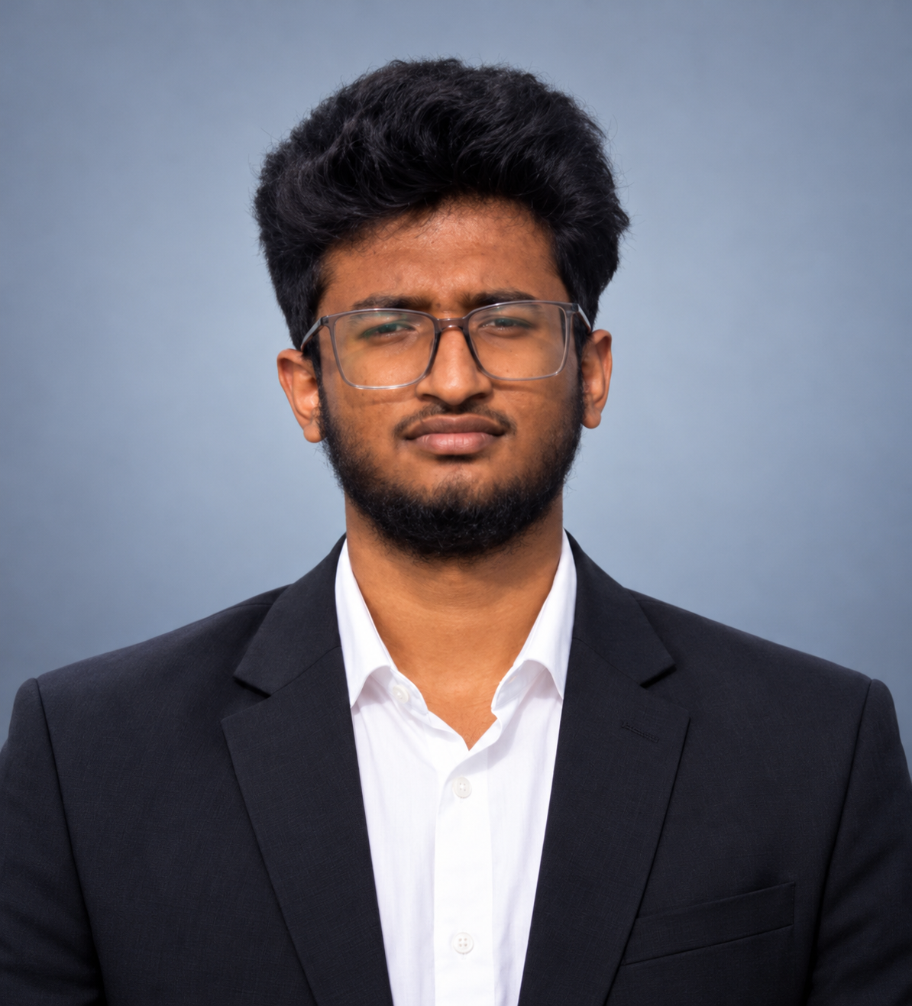
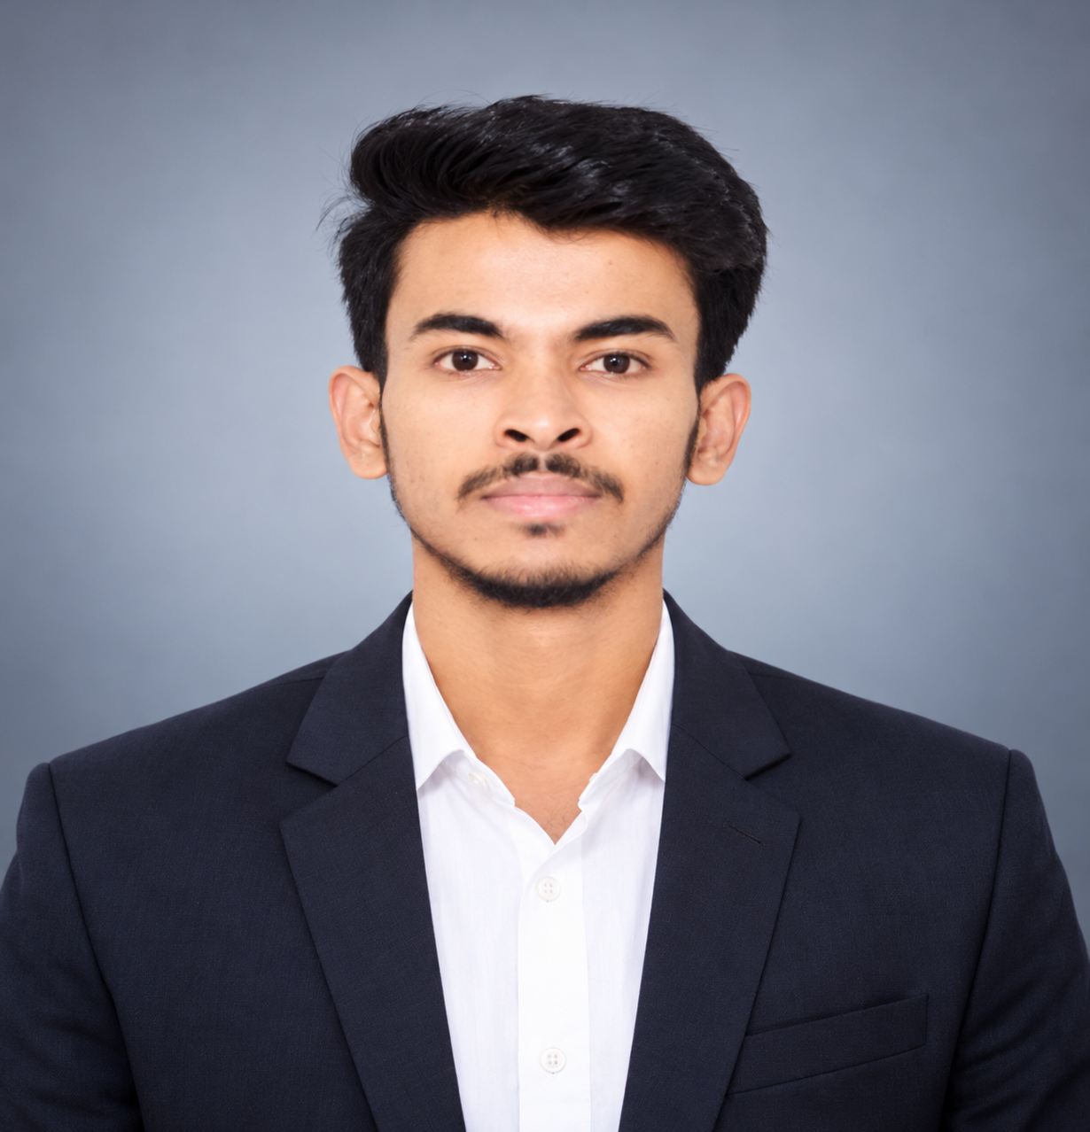
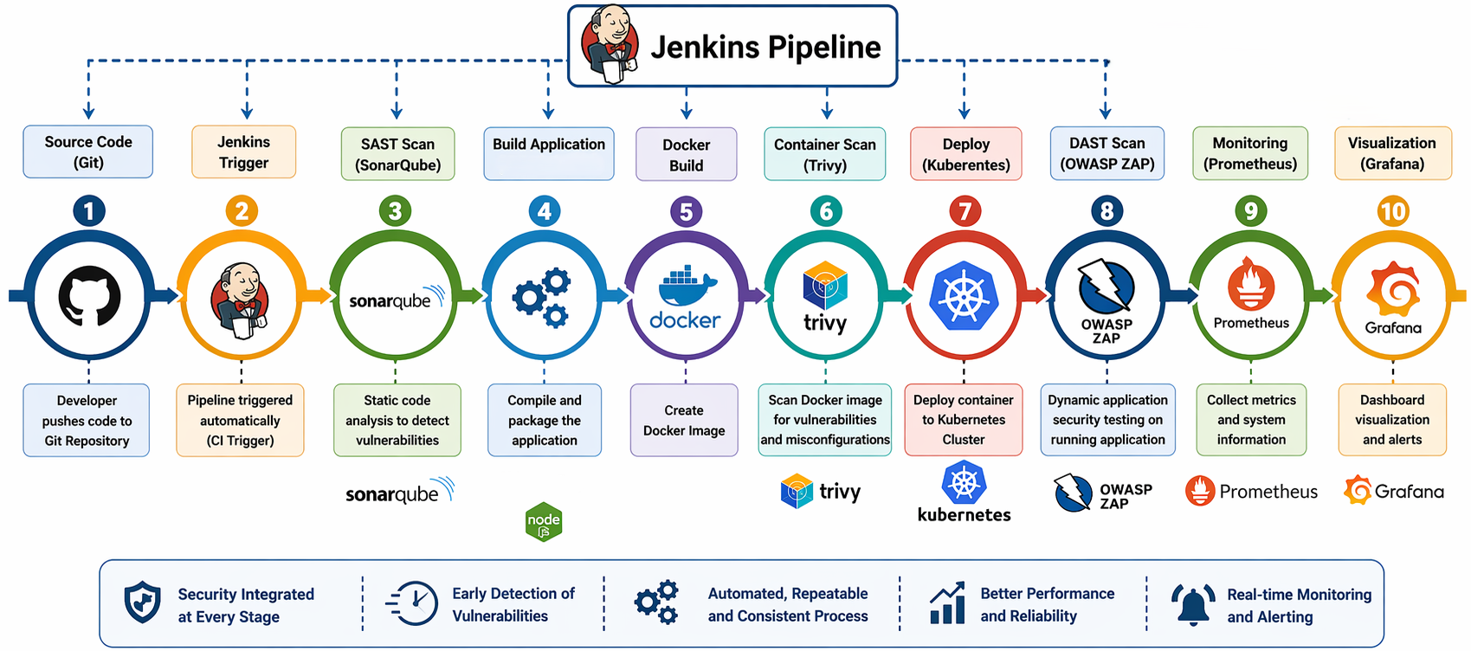
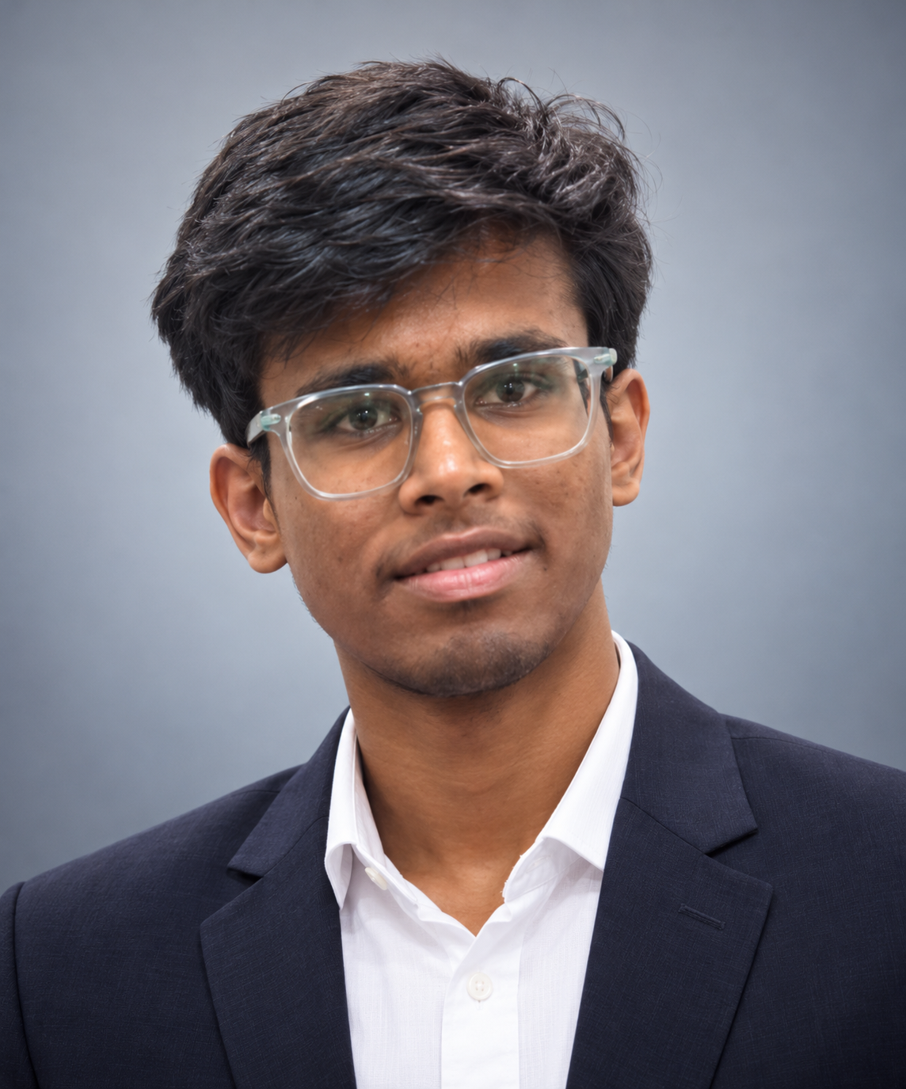
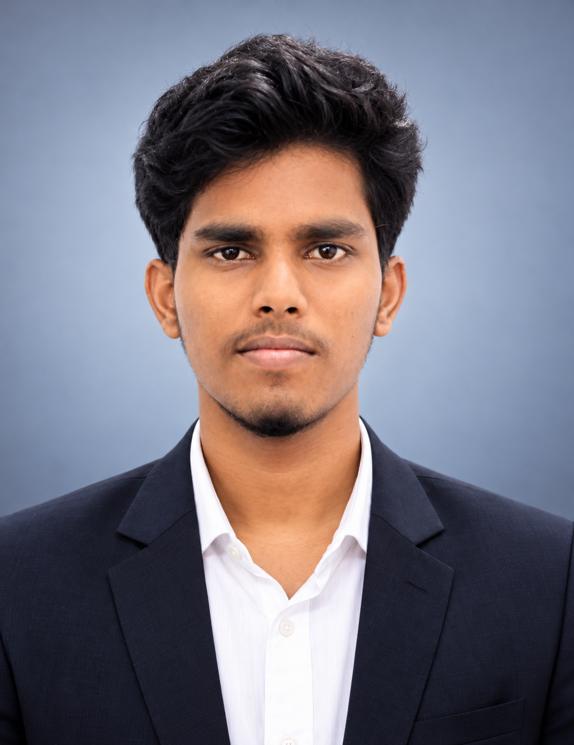
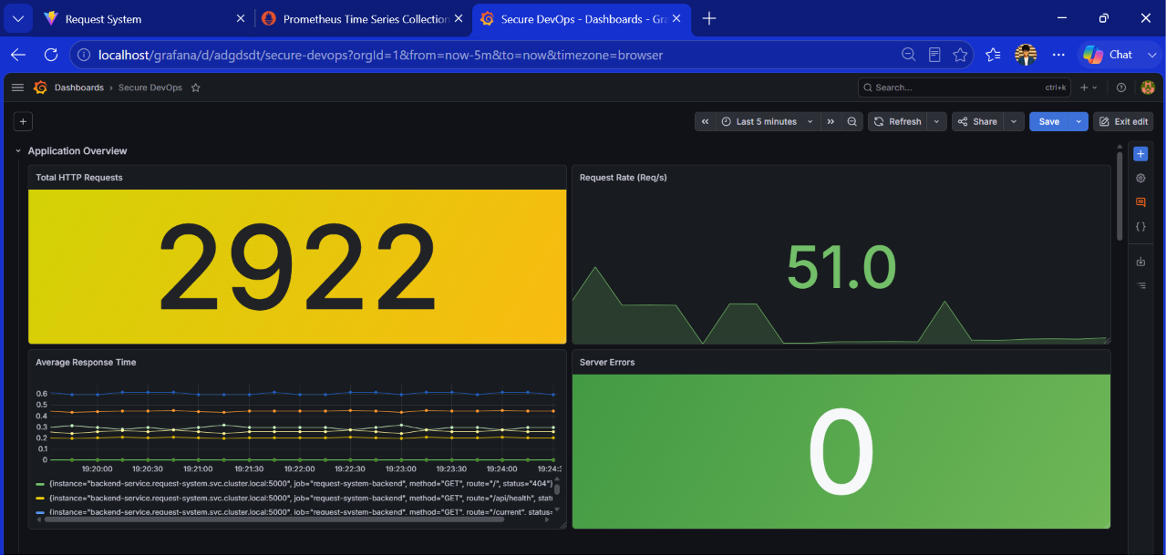
GLOBAL ACADEMY OF TECHNOLOGY
An Autonomous Institute, Approved by AICTE, New Delhi, Affiliated to VTU
Ideal Homes Township, Rajarajeshwari Nagar, Bengaluru – 560 098
SDG Logo
ANVESHANAM – 2026
A Capstone Project Exhibition
Department of Computer Science and Engineering
Secure CI/CD Pipeline with Integrated Security Testing
Innovate • Build • Showcase
Group No.: G14
OBJECTIVES
SYSTEM Overview
RESULTS
To design and implement a secure CI/CD pipeline
To integrate security testing tools into DevOps workflows
To identify and mitigate vulnerabilities at early stages of development
To reduce security risks and remediation costs
To ensure faster and secure software delivery
Evolution of DevOps: From Speed to Security
Fig 1: Jenkins DevSecOps Pipeline showing successful execution of CI/CD stages
PROJECT TEAM
 | USN | Student Name
 | 1GA23CS137 | Revanth Kumar T S
 | 1GA23CS148 | Sanket
 | 1GA23CS151 | Shakthi Vel K
 | 1GA23CS193 | Vignesh P
SYSTEM ARCHITECTURE
Fig 2: SonarQube dashboard showing a passed Quality Gate with no new issues or security hotspots.
Role | Name
Project Guide | Prof. Sameena H S
Project Coordinator | Dr. Shruthi G
Head of Department | Dr. R Rajkumar
Academic Year: 2026–2027
Fig 3: Grafana dashboard showing application requests, response time, and server error metrics.

